Slide 1
Budget Development for Sponsored Projects
Catherine Cuppett, Sponsored Projects Administration
September 2016

Slide 2
What are the main parts? How do I start?
RFP or RFA
Scope of Work
Budget
Budget Justification
Notes:
Proposal – a document written to apply for funds to be used for a specific project.
Identifies a problem or need
Offers a solution
Identifies cost
What will the RFA tell me? – IDC limits, award amount limits, duration, restrictions on how funds are spent, etc.
Scope of work should dictate costs within the limits of the RFA
This will help create your budget
The justification should flow naturally as a written narrative of what the cost categories are and how they relate to the project.

Slide 3
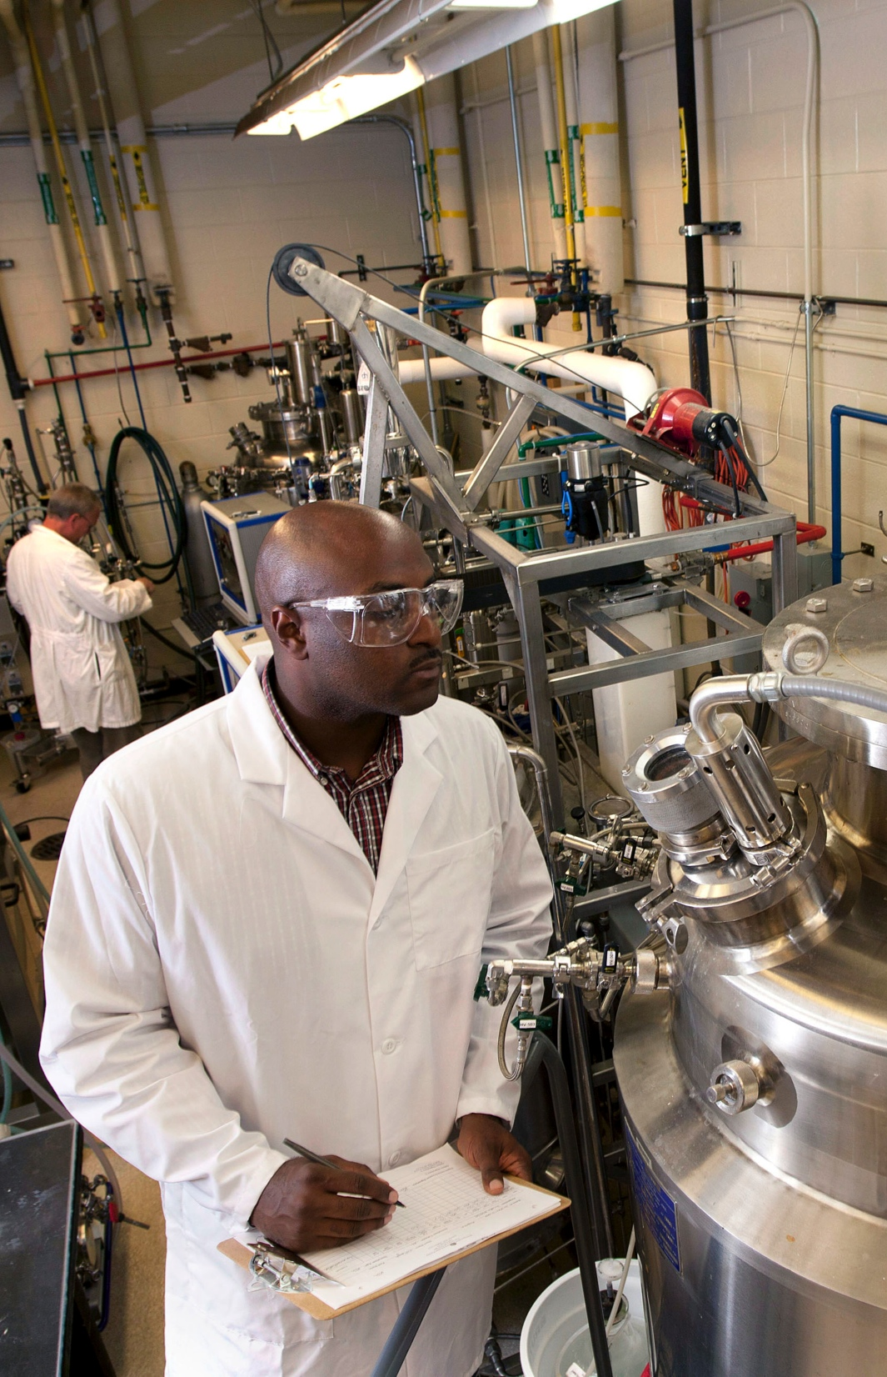
Budget Development
Direct Costs
Allocable
Allowable
Reasonable
Types
Salary & Fringe
Materials and Supplies
Travel
Equipment
Notes:
Direct Cost Policy at UGA - http://www.policies.uga.edu/FA/nodes/view/864/Direct-Cost - Cost that can be identified specifically with a particular sponsored project, or that can be directly assigned to such activity relatively easily and with a high degree of accuracy.
- personnel
- equipment
- travel
Supplies
subrecipients
consultants

Slide 4
Direct Costs
Personnel Costs
Identifiable
Working on project
Within project period
100% is 100%
Rates are set by HR
Raises
UGA Employees
Notes:
Personnel costs - includes salary and fringe benefits for faculty, staff, and students working on the project.
Must be specifically identified and utilized on a project.
Must be paid within the project period.
Federal rules prohibit an employee from earning more than 100% of his/her salary. This rule applies even across multiple awards, whether federal or non-federal.
Salaries are determined by Human Resources’ Employment Classification System.
Proposed salaries can be increased in project out years to reflect anticipated raises, promotions, or reclassifications. However, if no raises are approved at UGA in a given year, salary increases are not allowed.
All employees---whether paid from a grant or a state account---are UGA employees.

Slide 5
Direct Costs
Fringe Benefits
Estimated at time of proposal, but actual rates are charged to the grant.
Equipment
Items with a useful life of more then 3 years and a cost of $5,000 or more
Travel
Per diem, airfare, mileage and conference registrations for employees working on sponsored projects in furtherance of the project
Supplies
Refers to lab/research or programmatic supplies needed to complete a specific scope of work.
Notes:
Fringe benefit rates - http://research.uga.edu/spa/frequently-used-information/ - change yearly
- If funded, the individual’s actual rate will be charged to the project. This amount can vary from month to month. This can affect the project’s budget. If the actual fringe amount is more, the project’s budget must cover the higher amount. If the actual fringe amount is less, the project’s budget can be revised to use those funds in another way.
Sick and vacation pay and holiday pay are to be met by the grant (you may require grant-funded employees to take regular leave days!)
Application of staff benefits: http://policies.uga.edu/FA/nodes/view/859/Application-of-Staff-Benefits
Equipment - Must be specifically identified with and utilized on a project.
Must be purchased within the project period, and typically, not at project end.
General purpose equipment is considered an F&A cost.
Normally excluded from calculations when determining MTDC.
Equipment purchases not included in the award budget may require sponsor approval
Sometimes, individual components costing less than $5,000 are so integral to a system that the sum total of the parts is capitalized, and thus treated as equipment in the budget
Supplies - Glassware
Reagents
Solvents
Chemicals
Test booklets
Always differentiate between office supplies and lab supplies in the budget justification. Office supplies may not be allowed because these types of costs are included in UGA’s Indirect / F&A charges. If allowed, a detailed justification will be required for an exception approval.

Slide 6
Direct Costs
Try to think through your project in details. For example if you are using animals ask yourself things like:
Do you need a per diem for their care?
Where will they be housed?
Are there cage costs?
Do you need a rack?
Will you need special veterinary services to do your project?

Slide 7
Direct Costs
Subrecipient or Subcontractor
A third-party organization performing a portion of work on a prime UGA or UGARF award. In contrast to a vendor, a subrecipient performs part of the scope of work of the project.
Consultant
Third part providing highly technical or professional advice. Does not control the manner in which the work is performed. Does not engage in programmatic decision making.
Sub vs. Consultant
Notes:
What is the difference between a subrecipient and a consultant or vendor?
A consultant or vendor does not make programmatic decisions
A consultant or vendor tends to have a billing rate
Staff conducting work are not identified
The same types of services are offered to a variety of customers
Examples include: lab testing, report printing, website design, etc. that are part
of regular business operations

Slide 8
Indirect Costs
Indirect Costs (IDC) or Facilities and Administrative Costs (F&A)
Costs that are necessary to support sponsored projects, but are not easy to identify, quantify, and link directly to the scope of work of a project.
Pre-Award can help you figure out which rate to use.

Slide 9
 | Federal | Non Federal
Research On-Campus (7/1/13 - 6/30/15) | 49% | 60%
Research On-Campus (7/1/15 - 6/30/16) | 50% | 60%
Research Off-Campus | 26% | 35%
Instruction On-Campus | 56% | 94%
Instruction Off-Campus | 26% | 62%
Research Ag. Experimental Station | 40% | 53%
Public Service Agreements On-Campus | 37% | 50%
Public Service Agreements Off-Campus | 26% | 39%
Marine Institute Sapelo Island | 35.5% | 42%
Marine Extension Bruns / Skidaway | 46% | 55%
Cooperative Extension All Locations | 30% | 38%
Research Savannah River Ecology Lab | 34% | 56%
Research Skidaway Island Institute of Oceanography | 50% | 60%

Slide 10
Where does IDC go?
Each fall UGA returns 20% of each sponsored project’s reimbursed F&A costs, based on expenditures made in the previous fiscal year.
F&A returns are typically made to the budgetary unit managing the award, but can be to other units, depending on the info provided by the PI/co-PI in the eResearch Portal.
http://www.policies.uga.edu/FA/nodes/view/809

Slide 11
Other Considerations: Effort
Effort – the amount of time PI(s), faculty, and other senior personnel spend on a particular activity.
Most proposals must show the percentage of effort committed to the project.
The percentage of effort should be commensurate with the percentage of salary requested.
More than 100% awarded effort is not allowed
http://policies.uga.edu/FA/nodes/view/860/Committed-Effort

Slide 12
Other Considerations: Effort
Salary savings
Each college/center has an incentive plan for ensuring faculty charge effort to projects
Funds can be used to cover a variety of costs

Slide 13
Other Considerations: Cost Share
Cost Share - refers to that portion of the total project costs not borne by the sponsor.
Cash Match - Cash contributions made to a project by UGA, UGARF, or a third party.
In-Kind Match - The reasonable value of personnel effort, equipment, materials or other property used in the performance of a statement of work.
Third-Party Match - Any expenditure necessary to complete a project that is borne, not by the sponsoring agency or the prime award recipient, but by a third party.

Slide 14
Other Considerations: Cost Share
Mandatory – The cost share must be included in the proposal budget in order to be considered for funding by the sponsor, as outlined in the RFP. It is a requirement as a condition of the award.
Voluntary - The cost share is not required by the sponsor but is offered by the applicant in the proposal. Once cost share is offered, it becomes a binding commitment and must be honored, if the project is funded.
Notes:
Some Federal agencies have established specific policies and guidelines for cost share, such as salary caps, a standard 25% requirement, or that cost share is not required/allowed
Once committed, costs can not be used on any other project
Federal funds can not be used as cost share, unless authorized by the federal sponsor.
Cost sharing reduces our F&A
Reduced F&A means more state dollars must fill the void
A mention of cost share anywhere in the proposal means UGA’s accountants have to track and report it. Pay special attention to the proposal narrative, budget, and budget justification.
http://policies.uga.edu/FA/nodes/view/862/Cost-Share

Slide 15
Other Considerations: Cost Share
How is cost share tracked?
A companion account is set up that is yoked to the restricted account.
Anything cost shared (in-kind or cash) has to be moved to the companion account.
Cost share obligations must be met.
Ideally we like to:
Avoid volunteering cost share
Use sponsor funds to pay for your effort

Slide 16
Budget Justification
A narrative clarification of each of the budget components
Explains how dollar amounts were determined
Indicates how each item relates to the research plan
All items must be justified – don’t assume their use is obvious to reviewers
Explains the who, what, when, where, and why
Be sure to explain if meals, visa fees, international travel, and/or incentive payments are critical to the project
Listing items is not sufficient for a justification, especially for a CASB exception. A detailed explanation must be included for all requested funds.

Slide 17
Example #1

Slide 18
Example #2
Due to the remote off-campus and out-of-state research sites, various laboratory, safety, office supplies, and shipping materials/postage related to packaging, processing, and transporting seeds and samples will need to be purchased.

Slide 19
Questions?
Notes:
Monthly Portal Open House – 3rd Wednesday of Every month
GRASP Class on the Portal – Make and track a proposal
Individual or departmental training by request

Slide 20
research.uga.edu

